Slide 1

VAT in Cyprus Real Estate

Slide 2
VAT on Land (Sellers)
Agricultural / Commercial
If the sale involves agricultural land the VAT rate is 0%.
If the sale involves commercial land the VAT rate is 19%
Residential
If a company sells residential land then the VAT rate is 19%. (i.e. Banks, Developers or any other Company)
If a private individual sells residential land then the VAT rate is 0%/19%
If the seller is a private individual selling residential land in Cyprus and has not sold any property in Cyprus over their lifetime or in the past 10+ years, the applicable VAT rate may be 0%.
If the seller has sold another property in the last 10 years (around), the VAT rate might be 19%.
*Important Information for Acquiring land for building a permanent residence:
When the buyer is an individual, and the residential land for sale is subject to a 19% VAT, and the land is less than 1,500m2, with the purpose of building their own permanent residence, although the VAT payable is 19% in advance in this scenario, the buyer might, however, claim back the 14% VAT once they build their main residence on the land (subject to further conditions) and use it for 6 months. This reclaimable amount represents the difference between the standard VAT rate of 19% and the reduced VAT rate of 5%.

Slide 3
VAT on Land
It is worth to note that
If the sale involves residential or commercial land with an existing old building/house, the VAT rate might be 0%, as it could be deemed a "resale building/house" purchase.
However, once, we encountered a situation in Paphos involving a lovely home for sale in Stroumpi Village. The property was located in a residential zone with 100% building density, situated on a large land parcel of approximately 10,000m2. In this instance, the VAT authorities applied VAT to the remaining land proportionately.

Slide 4
VAT on Land
If the sale involves the transfer/sale of shares of a company that owns the property, there is no VAT applicable (and no transfer fees either) upon the transfer/sale of shares in a company owning the Cyprus property.
This approach is frequently used, especially in cases where companies possess a single asset, making the sale of the company more preferable than selling/transferring the property directly.
It is mostly applicable in cases where the property is considered "expensive," making it easier to sell.
However…The sale of shares in a company that owns real estate, is subject to capital gains tax at the rate of 20%.

Slide 5
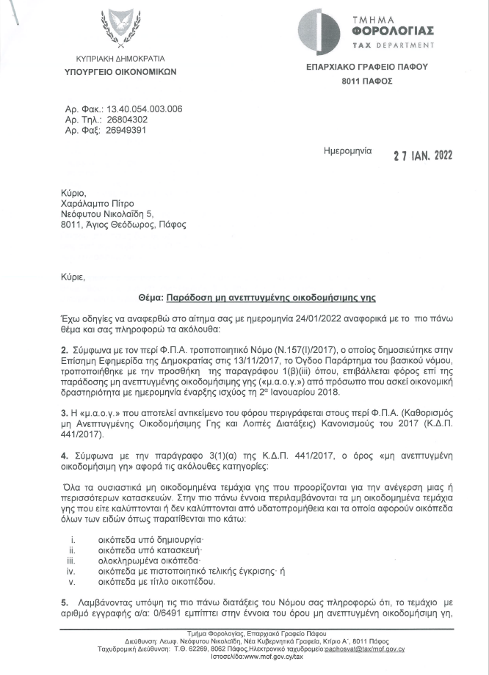
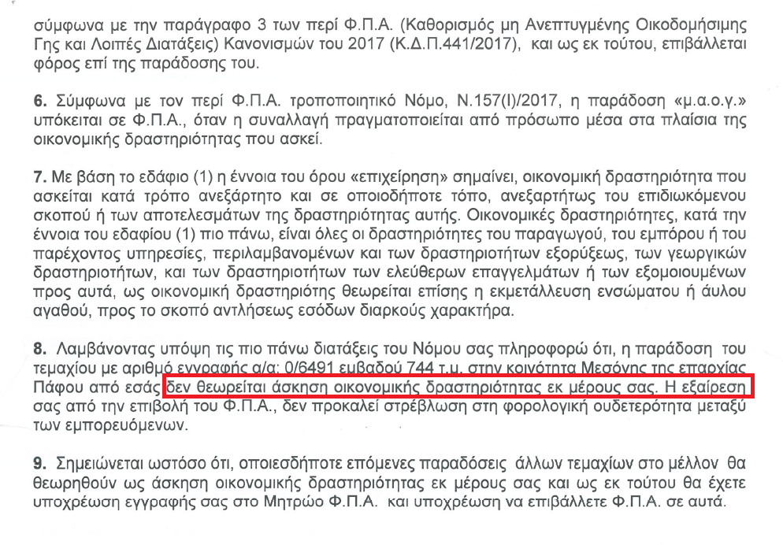
VAT on Land – Letter from VAT (NO VAT example)

Slide 6
VAT on Houses/Apartments (Reduced VAT policy for Permanent Residence)
For the application of the reduced VAT policy the main requirement is that owners must have an intention to live in for at least 10 years and that the applicant must not have another property that is used as a permanent residence in Cyprus.
*New VAT Policy
The Reduced VAT policy from 19% to 5% will apply to the first 130 sq. m on the main residence and up to a value of €350,000, provided that the total value of the transaction does not exceed €475,000 and that the total buildable area does not exceed 190 sq. m.
The law also provides for a transitional period, so that the new rules do not apply in cases where a planning permit has been issued already before 31st of October or where an application for a planning permit has been filed by 31st of October 2023.
*Previous Reduced VAT policy (Relevant for projects/properties that obtained a planning permit prior to the implementation of the new policy)
The reduced rate of 5% applies for the first net 200 square meters of the residence and without any price limit. In the event that families have more than 3 children, the permissible total covered area increases by 15 square meters for each additional child. (i.e. beyond the three children). For the remaining size of the house, the standard rate of VAT 19% is been applied.
This ‘‘old’’ VAT policy is applied in cases where a planning permit has been issued already before 31st of October or where an application for a planning permit has been filed by 31st of October 2023.

Slide 7
VAT on Houses/Apartments (Reduced VAT policy for Permanent Residence) What if I sell my property before the lapse of 10 years?
If an eligible person does not use his house (as his main residence) for at least 10 years and thus proceed with a sale or rent prior to the lapse of 10 years, then he is subject to the following procedure.
Within 30 days from the date of termination of such use (owner) must notify the Registrar and pay the difference between the reduced VAT fee (i.e. 5%) and the standard rate of VAT (19%) in relation to the remaining period.
For example a person bought a house at the price of €600,000 by utilizing a reduced VAT rate of 5%. Then he sells the house 3 years later from the initial date of use. Therefore on such case he required to pay the difference (i.e. 14% of VAT) for the remaining 7 years.
That is:
€600,000 x 5% = €30,000
€600,000 x 19% = €114,000
€114,000 – €30,000 = €84,000 (Difference)
€84,000 x 7/10 = €58,800 (what you pay)
*There is an exception in cases of: death or transfer of the dwelling to an adult child of owner.

Slide 8
VAT on Commercial or Other Properties
The standard VAT rate for commercial properties or properties used as a non-permanent residence is 19%
It is worth to note that for properties that are intended to be used for short-term lettings (for at least 10 years), the VAT rate is 0%. The rationality for this, is because on such cases, VAT rate will be charged on a daily basis on the short-term lettings like a ‘‘hotel’’ room.

